Slide 1
Analyzing CMIP6 Climate Data for Flood Prediction
Celine Wehbe

Slide 2
Analyzing CMIP6 Climate Data for Flood Prediction
BACKGROUND – Climate Modeling
It is a computational tool used by scientists to simulate and study Earth's climate system.
It involves using mathematical equations to describe the physical, chemical, and biological processes that drive the climate system, and make predictions about future climate conditions.
It is used to study a wide range of phenomena, including temperature changes, sea level rise, ocean circulation, and the impact of human activities on the climate.
It is an essential tool for understanding how the climate system works and for developing strategies to mitigate the impacts of climate change.

Slide 3
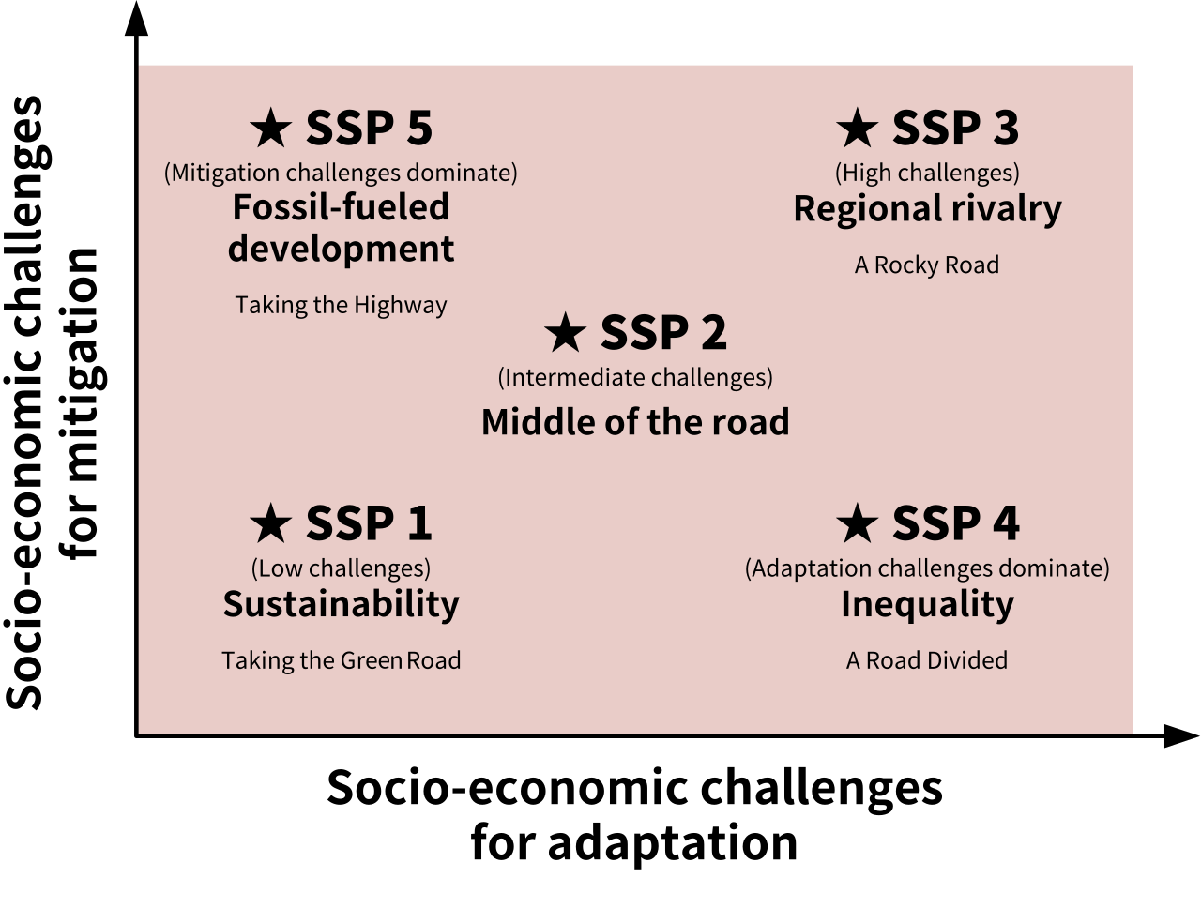
Analyzing CMIP6 Climate Data for Flood Prediction
BACKGROUND – Shared Socioeconomic Pathways (SSPs)
SSPs predict how climate change will change in response to socio-economic indicators such as population, economy, land use, and energy change.
SSPs range from SSP1, which represents a sustainable and equitable world with strong international cooperation and low population growth, to SSP5, which represents a fragmented world with high population growth and a focus on national interests over global cooperation.

Slide 4
Analyzing CMIP6 Climate Data for Flood Prediction
BACKGROUND – Representative Concentration Pathways (RCPs)
RCPs are GHG concentration trajectories adopted by the IPCC.
RCPs quantify future greenhouse gas concentrations and the radiative forcing due to increases in climate change pollution.
RCP2.6
RCP 8.5
…
radiative forcing

Slide 5
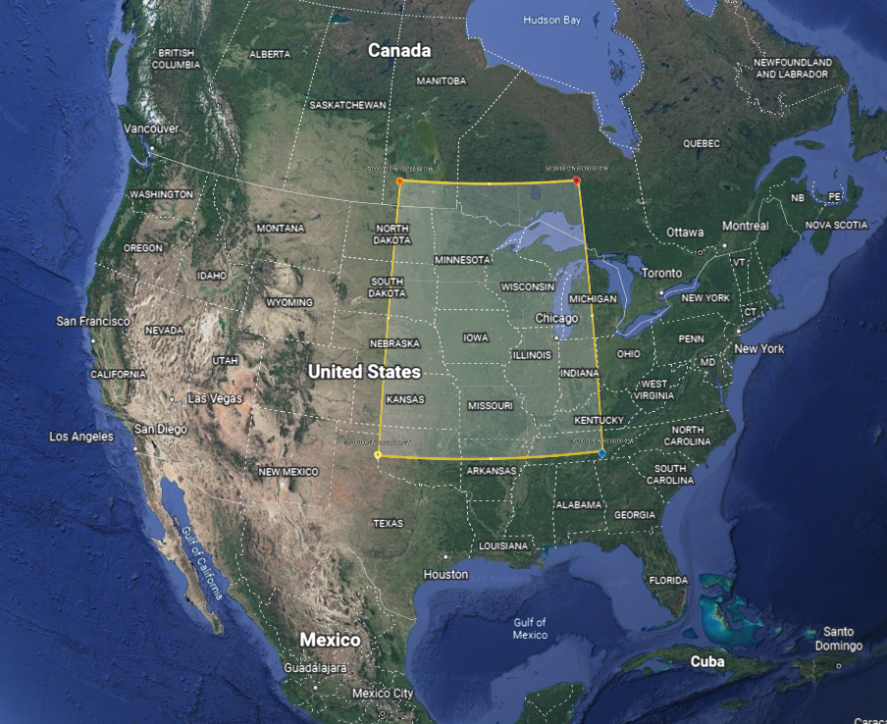
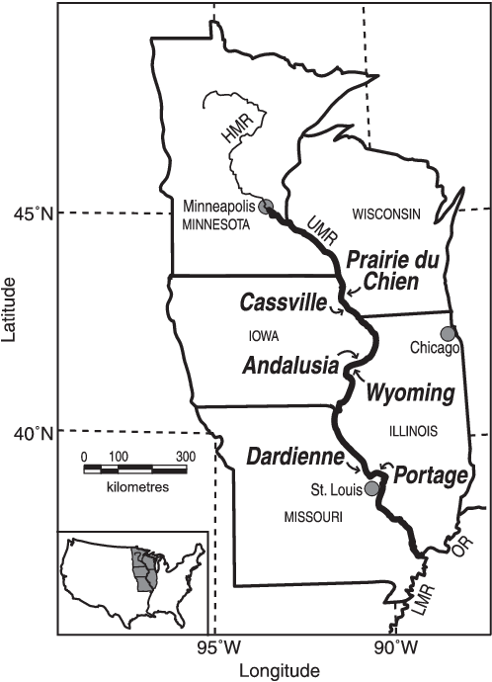
Analyzing CMIP6 Climate Data for Flood Prediction
BACKGROUND – Study Area & Timeline
Study Area: Upper Mississippi River
Timeline: 2015 - 2100

Slide 6
Analyzing CMIP6 Climate Data for Flood Prediction
SCIENTIFIC QUESTIONS
Main Project Objective: develop a data-driven approach to evaluate impacts of climate-related disruptions, such as flooding, along inland waterways, in this case study, the Upper Mississippi River.
Questions:
How does the change in radiative forcing due to increased pollution affect precipitations? What about changes in population, economy, land use, and energy use?
How do these changes vary over the years? Over the seasons?
Geographically, where are these changes most prominent?
How frequent are precipitation levels that can cause floods?

Slide 7
Analyzing CMIP6 Climate Data for Flood Prediction
METHODS – CMIP6
CMIP6: The Coupled Model Intercomparison Project Phase 6
Baseline: 2015
Variables: ‘pr’ for precipitation and ‘snw’ for snow
Temporal Resolution: daily
Spatial Resolution: 100 km
Experiment ID:
ssp126
Based on SSP1 and RCP 2.6. Future scenario with low radiative forcing by the end of century (net zero around 2075). Estimated warming of 1.4°C by 2100.
ssp245
Based on SSP2 and RCP 4.5. Future scenario with medium radiative forcing by the end of century (around current level until 2050, then decrease). Estimated warming of 2.7°C by 2100.
ssp370
Based on SSP3 and RCP 7.0. Future scenario with high radiative forcing by the end of century (double). Estimated warming of 3.6°C by 2100.
ssp585
Based on SSP5 and RCP 8.5. Future scenario with very high radiative forcing by the end of century (triple). Estimated warming of 4.4°C by 2100.
Notes:
SSP1: Sustainability (Taking the Green Road)
The world shifts gradually, but pervasively, toward a more sustainable path, emphasizing more inclusive development that respects predicted environmental boundaries. Management of the global commons slowly improves, educational and health investments accelerate the demographic transition, and the emphasis on economic growth shifts toward a broader emphasis on human well-being. Driven by an increasing commitment to achieving development goals, inequality is reduced both across and within countries. Consumption is oriented toward low material growth and lower resource and energy intensity.
SSP2: Middle of the road
The world follows a path in which social, economic, and technological trends do not shift markedly from historical patterns. Development and income growth proceeds unevenly, with some countries making relatively good progress while others fall short of expectations. Global and national institutions work toward but make slow progress in achieving sustainable development goals. Environmental systems experience degradation, although there are some improvements and overall the intensity of resource and energy use declines. Global population growth is moderate and levels off in the second half of the century. Income inequality persists or improves only slowly and challenges to reducing vulnerability to societal and environmental changes remain.
SSP3: Regional rivalry (A Rocky Road)
A resurgent nationalism, concerns about competitiveness and security, and regional conflicts push countries to increasingly focus on domestic or, at most, regional issues. Policies shift over time to become increasingly oriented toward national and regional security issues. Countries focus on achieving energy and food security goals within their own regions at the expense of broader-based development. Investments in education and technological development decline. Economic development is slow, consumption is material-intensive, and inequalities persist or worsen over time. Population growth is low in industrialized and high in developing countries. A low international priority for addressing environmental concerns leads to strong environmental degradation in some regions.
SSP5: Fossil-Fueled Development (Taking the Highway)
This world places increasing faith in competitive markets, innovation and participatory societies to produce rapid technological progress and development of human capital as the path to sustainable development. Global markets are increasingly integrated. There are also strong investments in health, education, and institutions to enhance human and social capital. At the same time, the push for economic and social development is coupled with the exploitation of abundant fossil fuel resources and the adoption of resource and energy intensive lifestyles around the world. All these factors lead to rapid growth of the global economy, while global population peaks and declines in the 21st century. Local environmental problems like air pollution are successfully managed. There is faith in the ability to effectively manage social and ecological systems, including by geo-engineering if necessary.

Slide 8
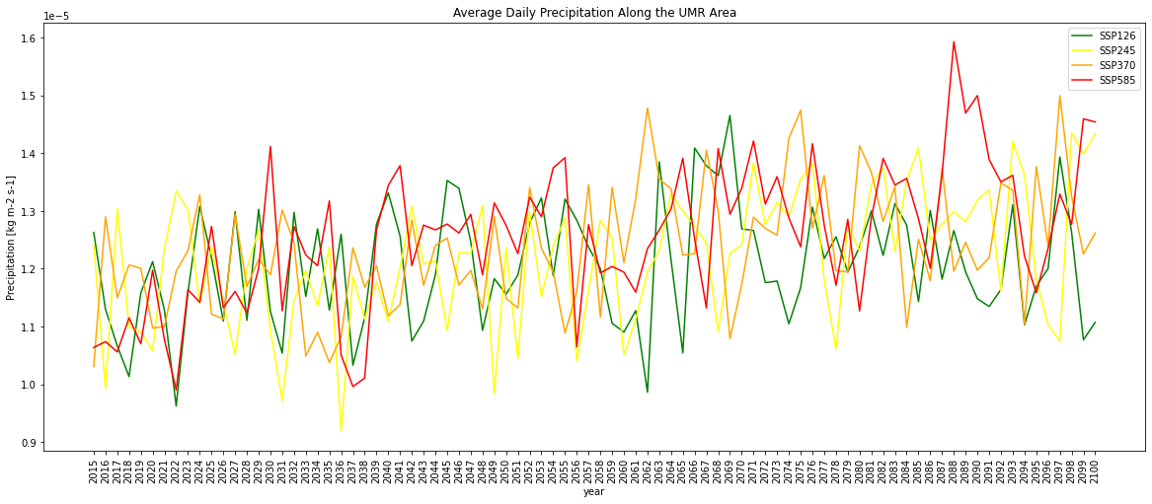
Analyzing CMIP6 Climate Data for Flood Prediction
RESULTS

Slide 9
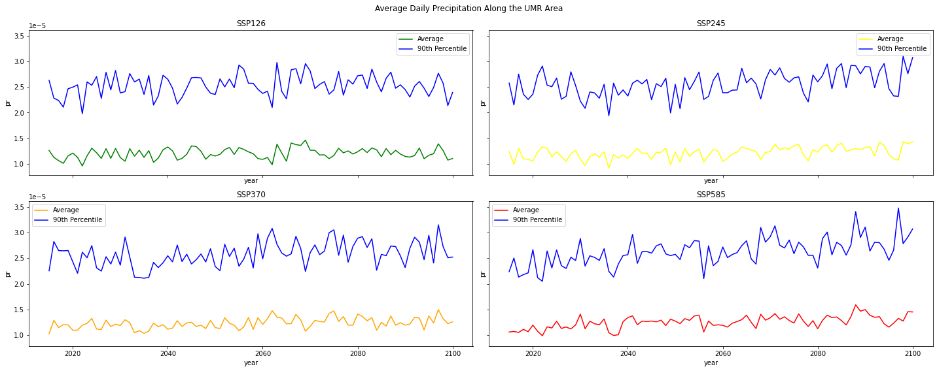
Analyzing CMIP6 Climate Data for Flood Prediction
RESULTS

Slide 10
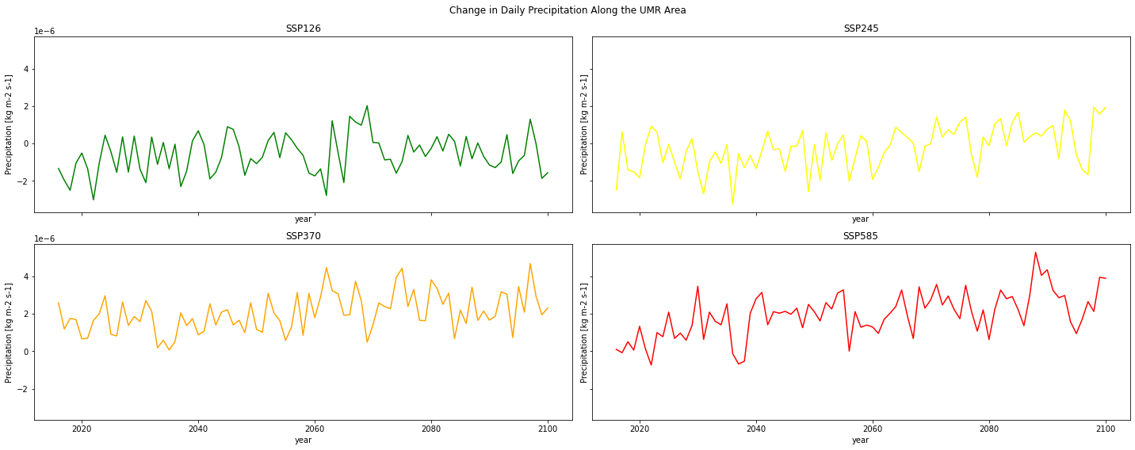
Analyzing CMIP6 Climate Data for Flood Prediction
RESULTS

Slide 11
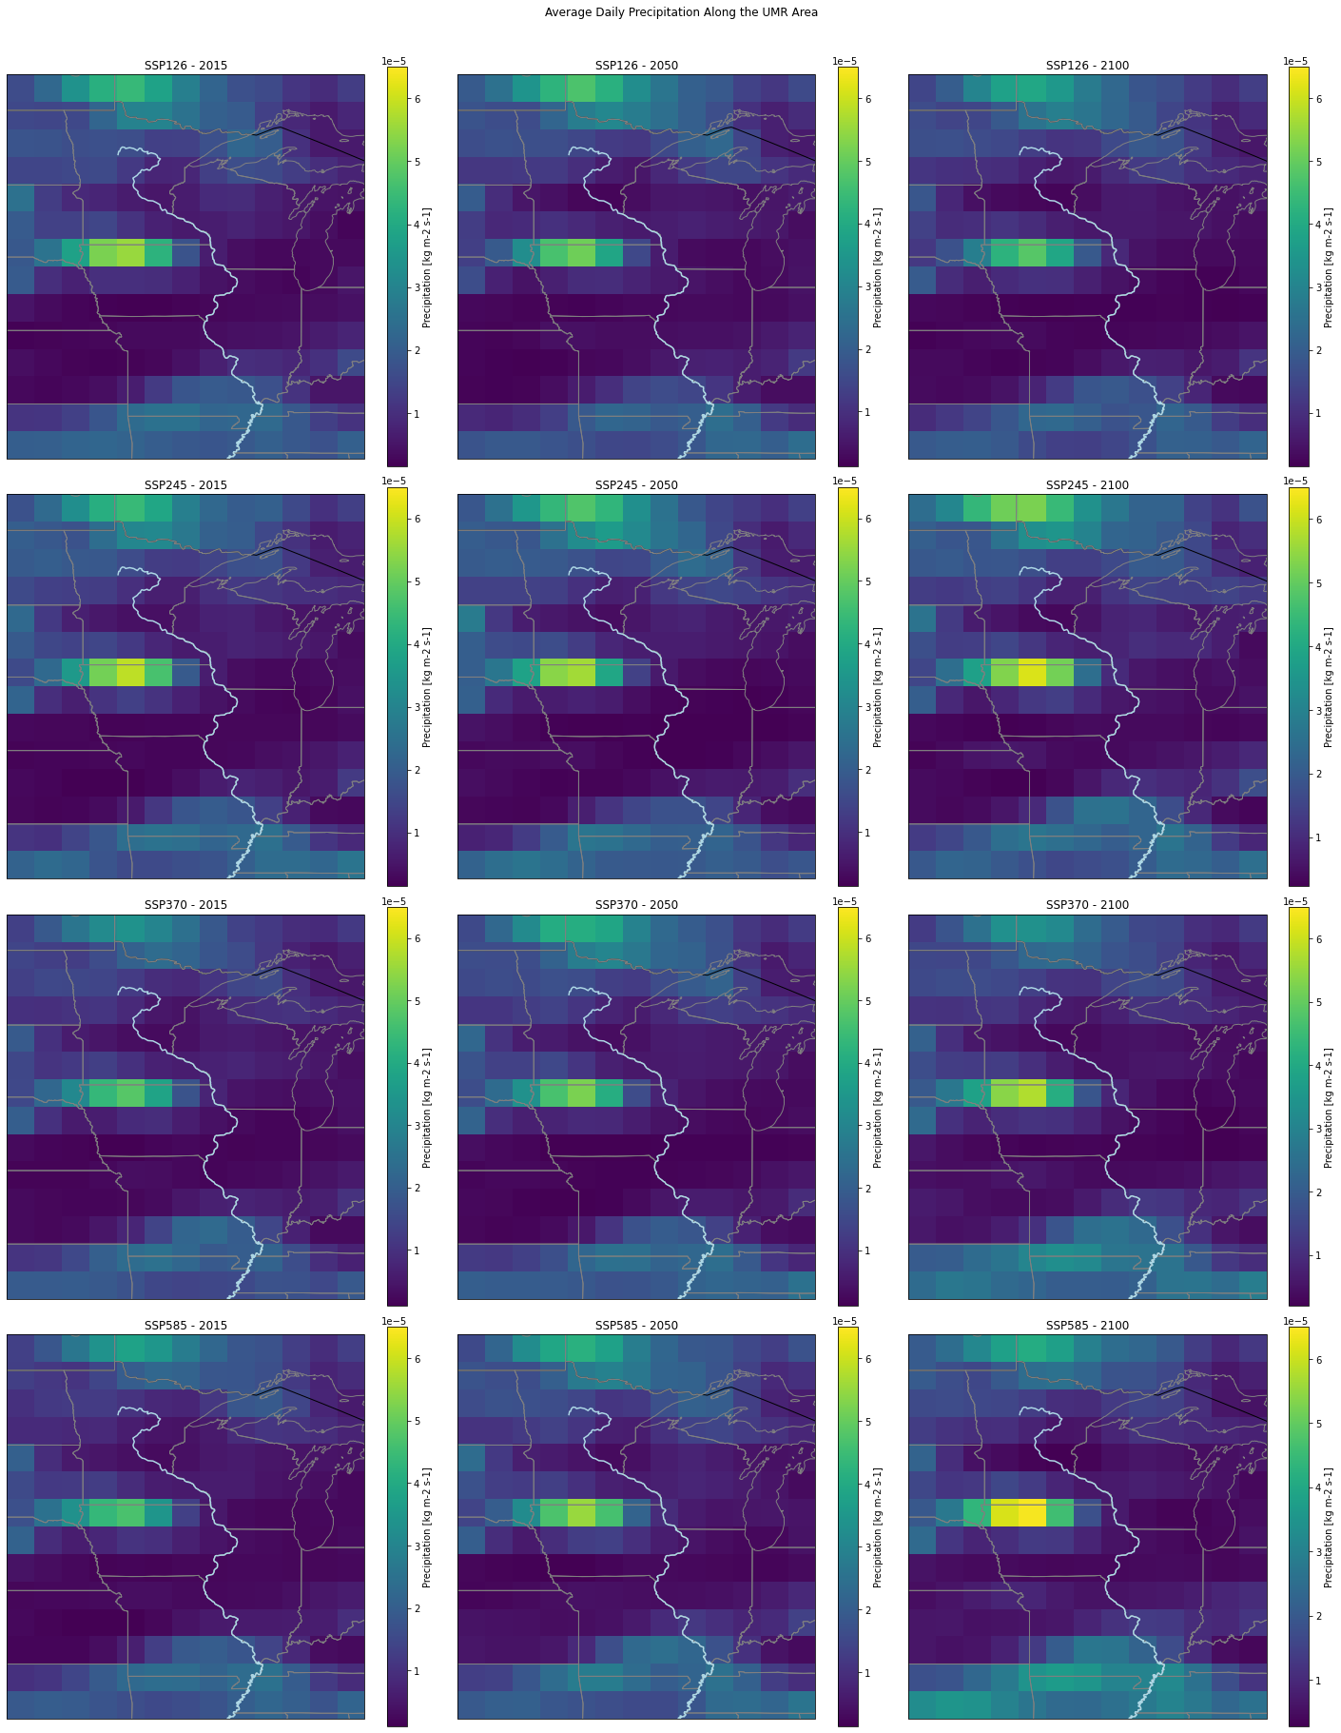
Analyzing CMIP6 Climate Data for Flood Prediction
RESULTS

Slide 12
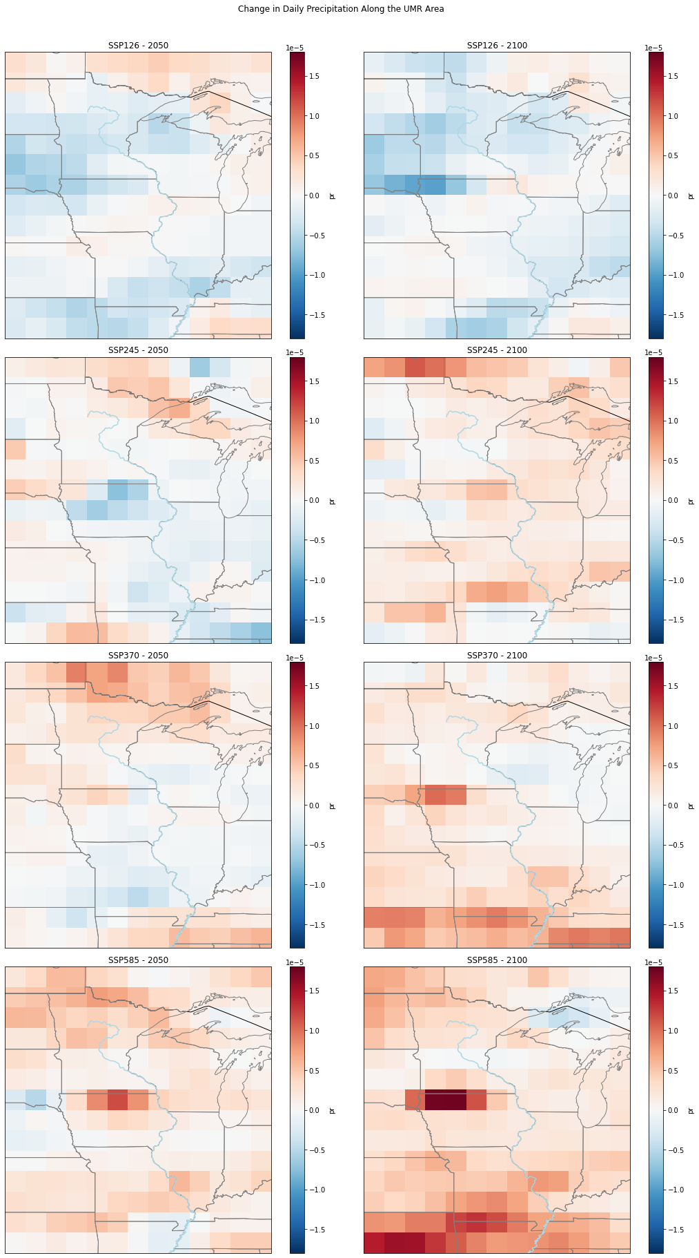
Analyzing CMIP6 Climate Data for Flood Prediction
RESULTS

Slide 13
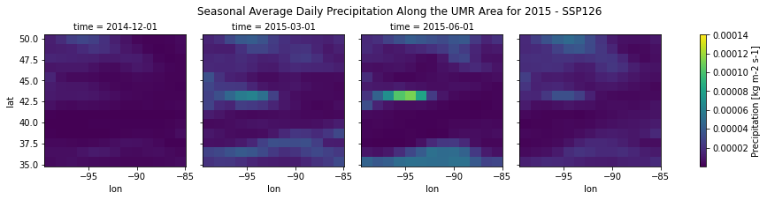
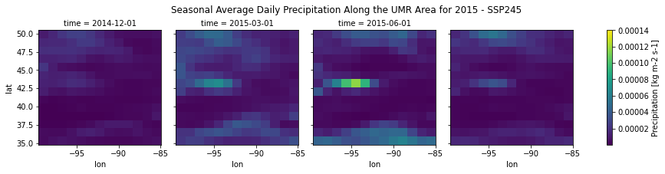
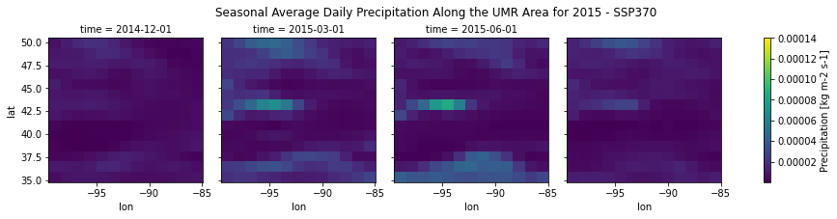
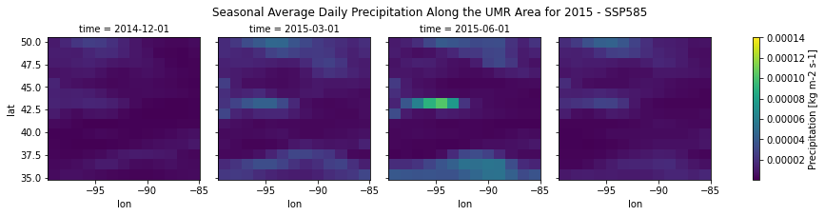
Analyzing CMIP6 Climate Data for Flood Prediction
SON
DJF
MAM
JJA
RESULTS
DJF
MAM
JJA
SON
DJF
MAM
JJA
SON
DJF
MAM
JJA
SON

Slide 14
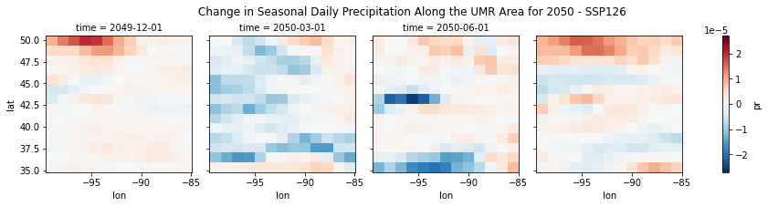
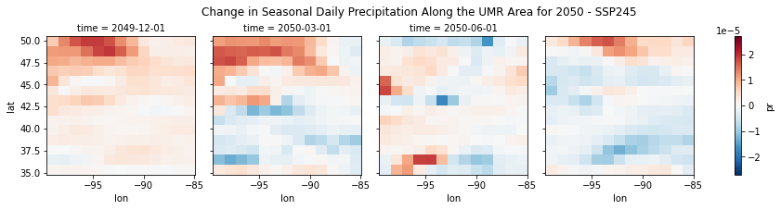
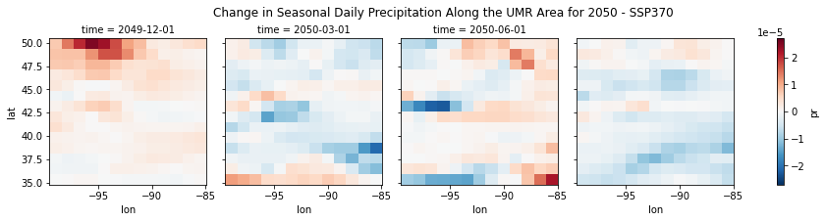
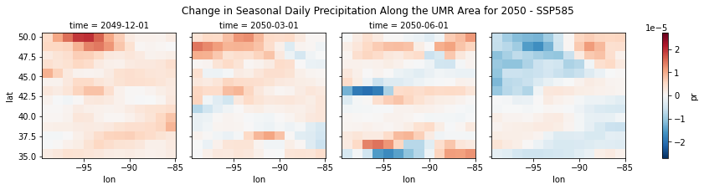
DJF
MAM
JJA
SON
Analyzing CMIP6 Climate Data for Flood Prediction
RESULTS
DJF
MAM
JJA
SON
DJF
MAM
JJA
SON
DJF
MAM
JJA
SON

Slide 15
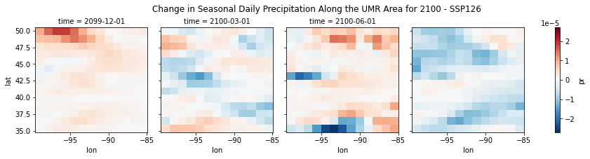
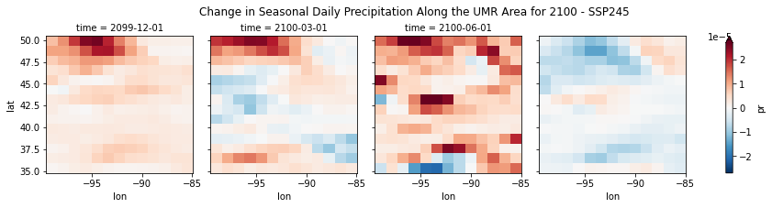
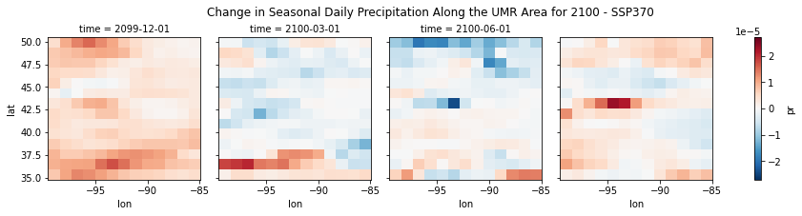
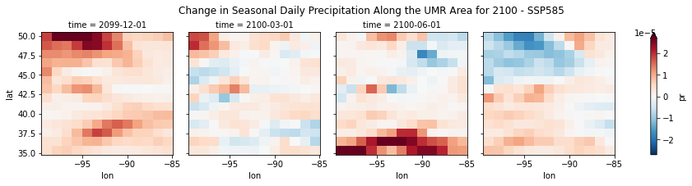
Analyzing CMIP6 Climate Data for Flood Prediction
SON
DJF
MAM
JJA
RESULTS
DJF
MAM
JJA
SON
DJF
MAM
JJA
SON
DJF
MAM
JJA
SON

Slide 16
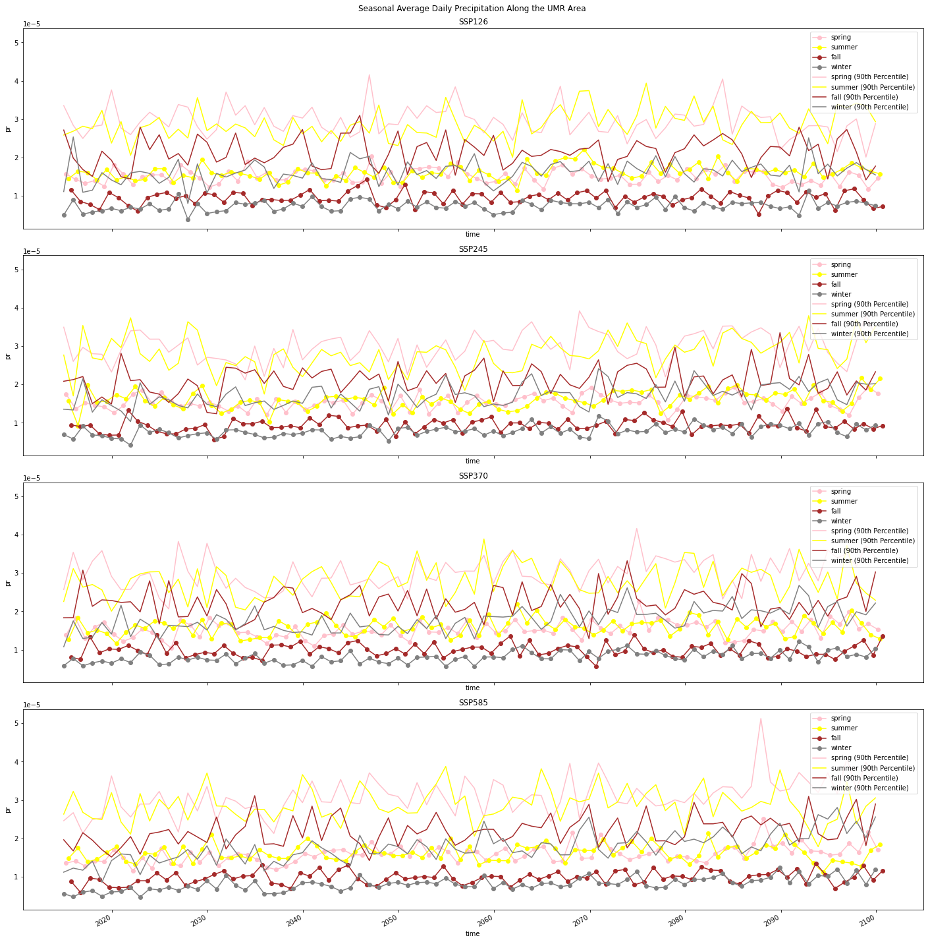

Slide 17
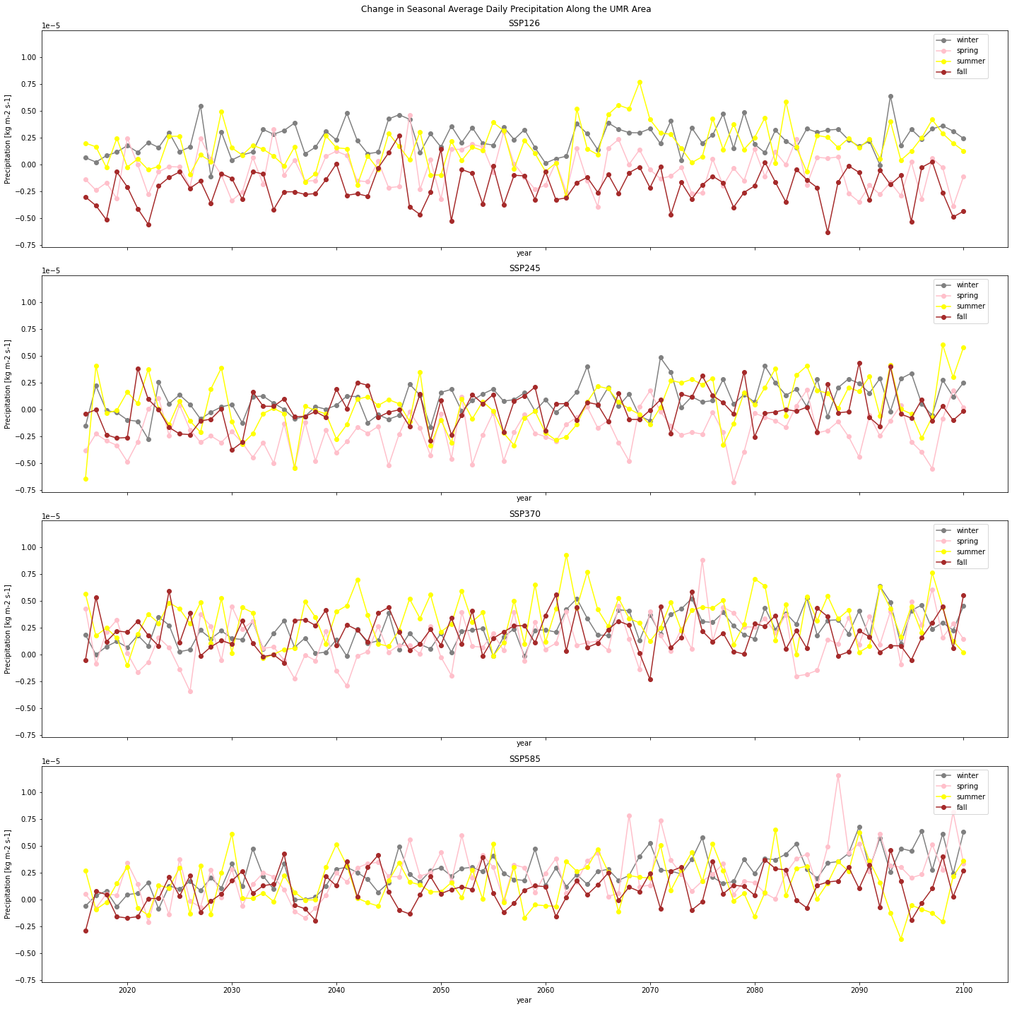

Slide 18
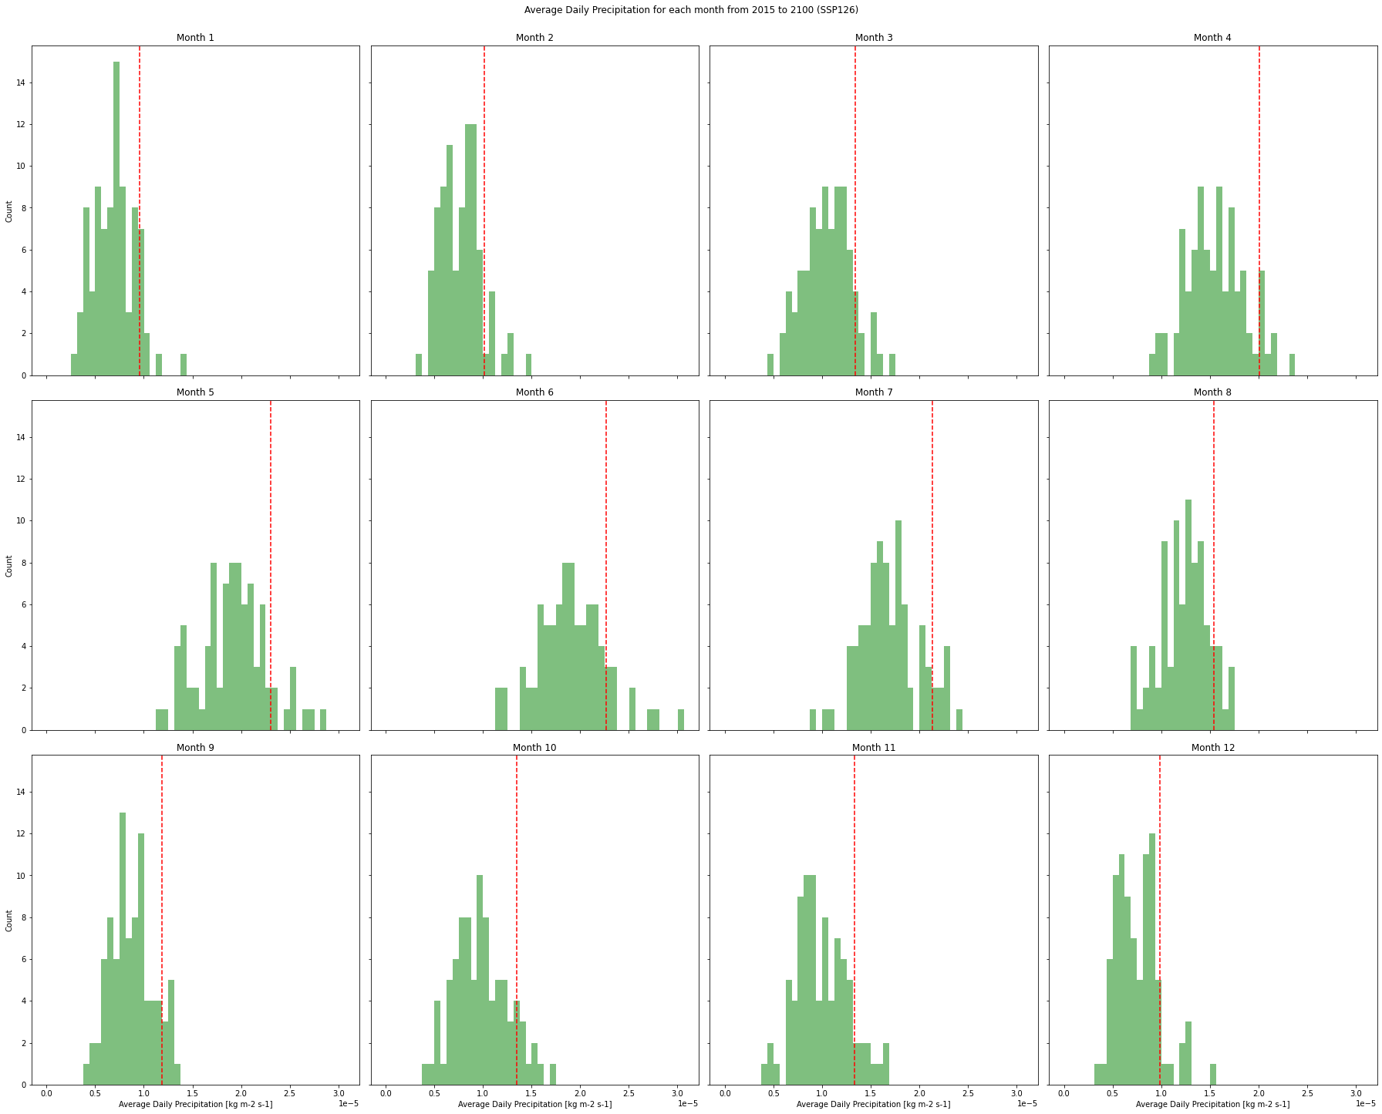

Slide 19
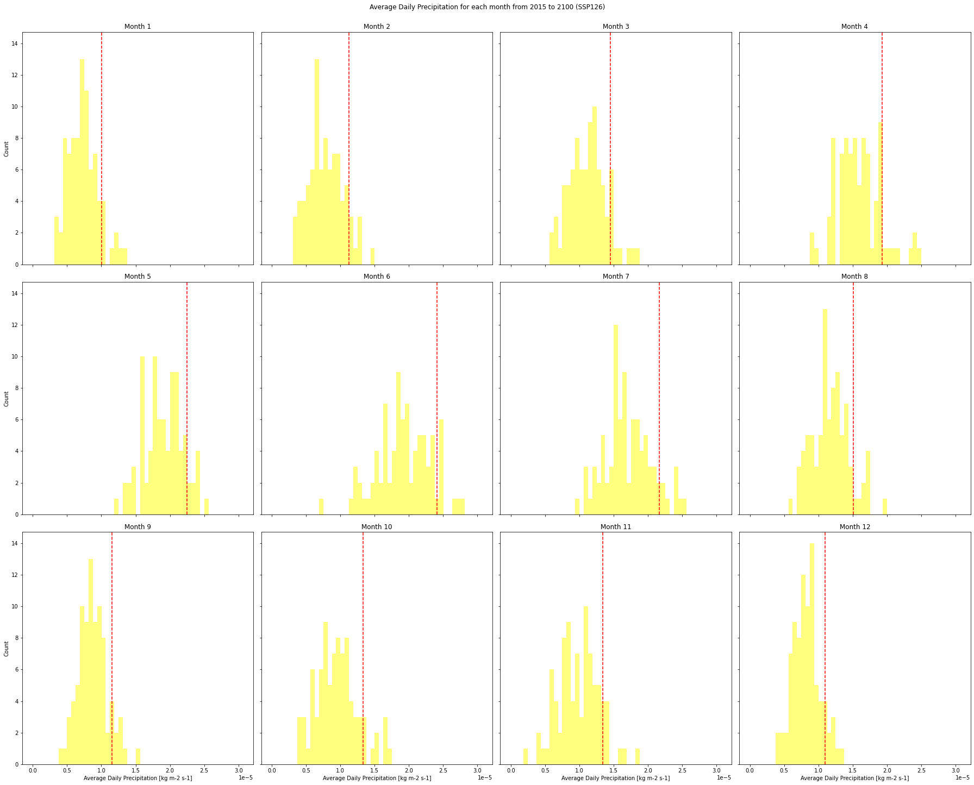

Slide 20
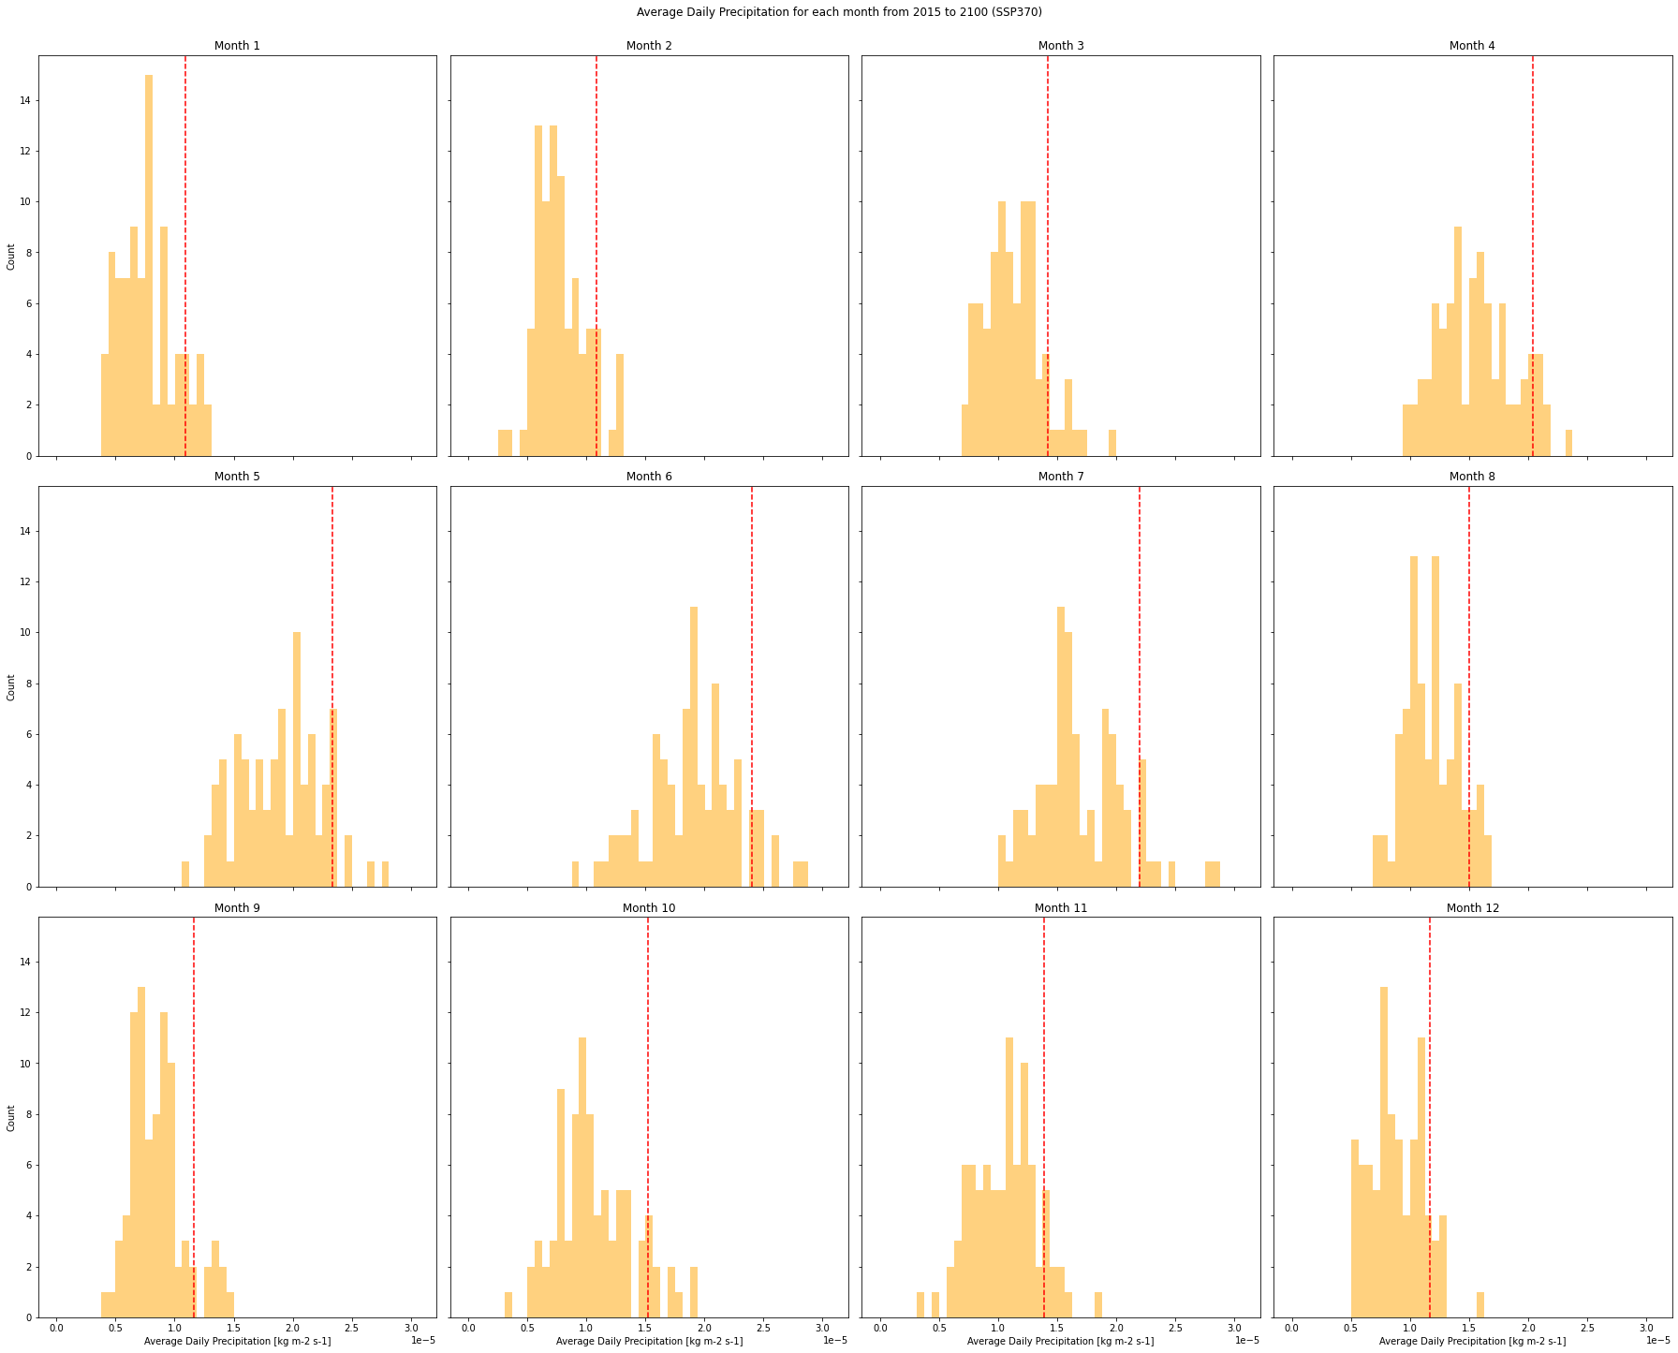

Slide 21
